Slide 1
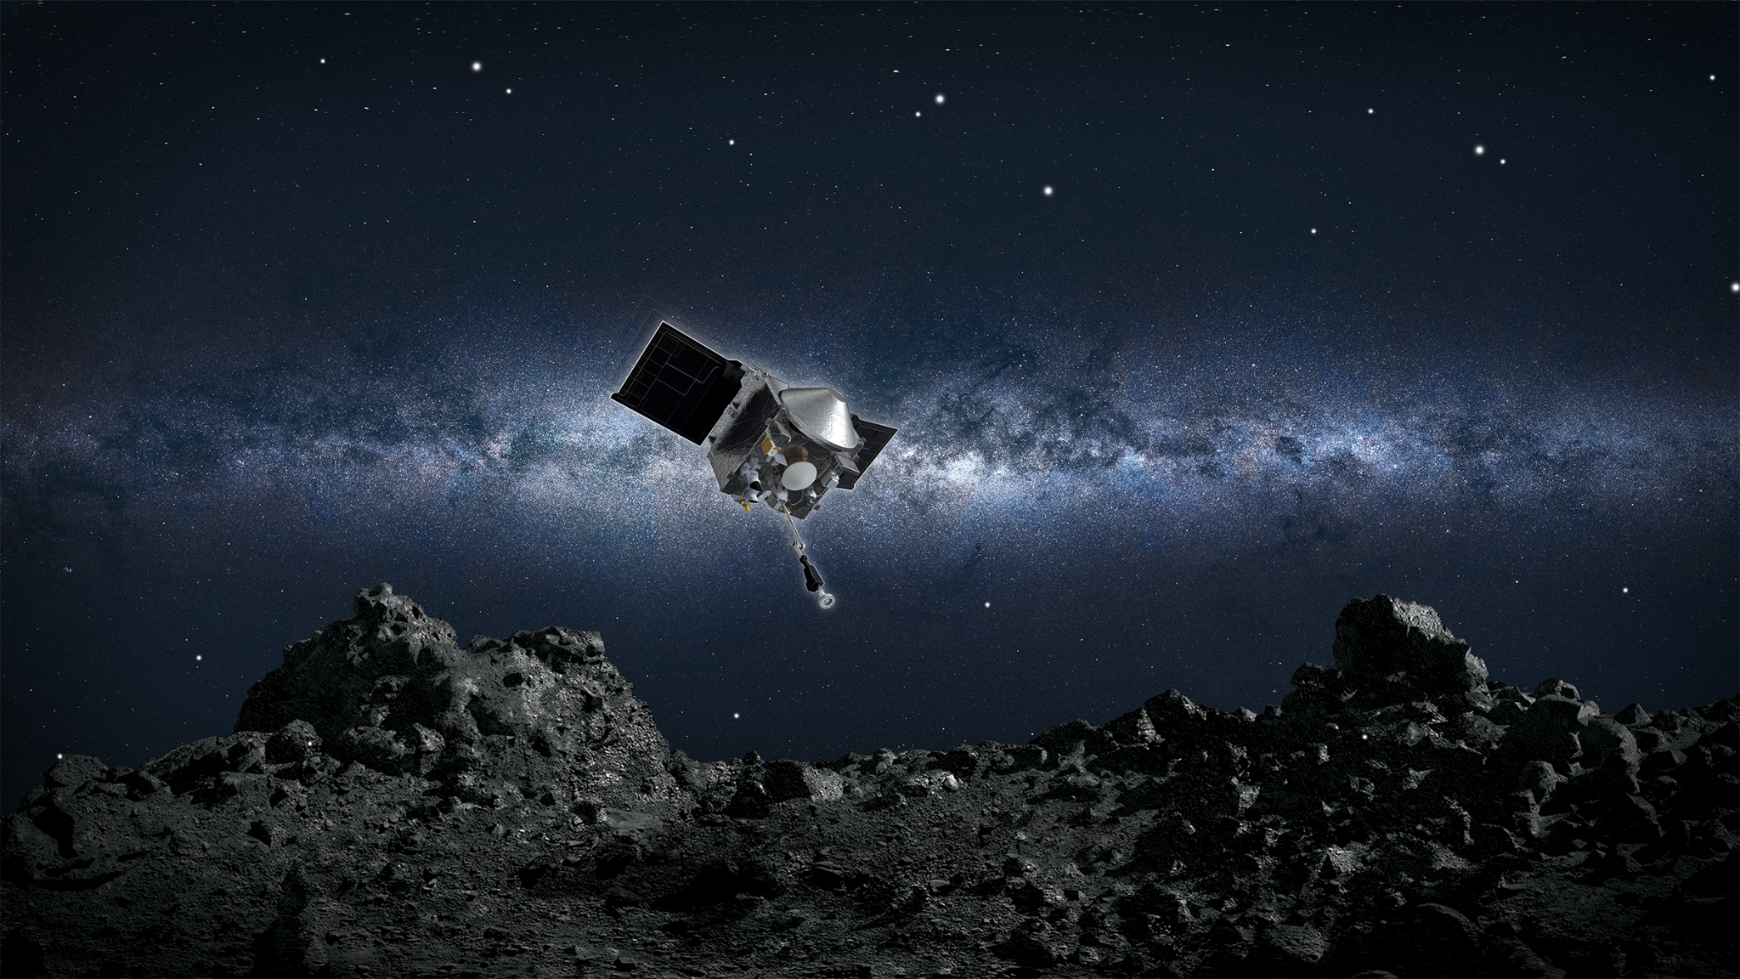




Structured Light Scanner use in OSIRIS-REx Sample Analysis
By: Laurinne Blanche ^{1, 2}, Andrew Ryan ¹, Carina Bennett ¹
Arizona Space Grant Consortium, Statewide Student Research Symposium, April 22, 2023, Tempe, AZ
1. Lunar and Planetary Laboratory, The University of Arizona, Tucson, AZ 85721, USA,
2. Materials Science and Engineering, The University of Arizona, Tucson, AZ 85721, USA

Slide 2

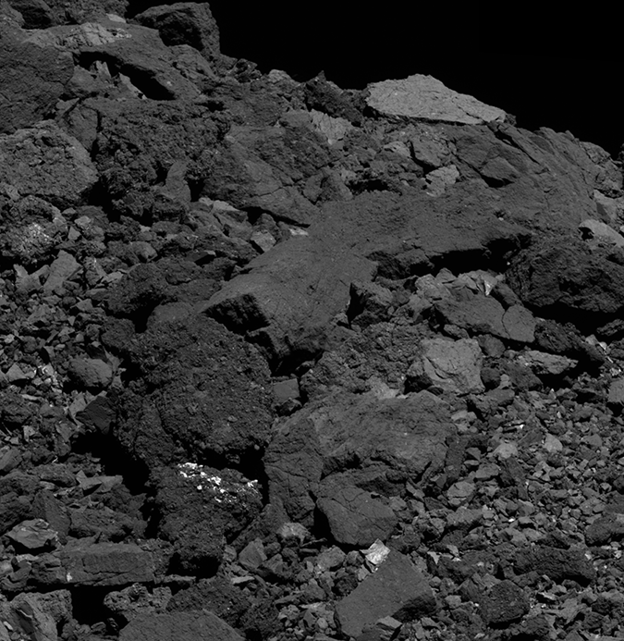
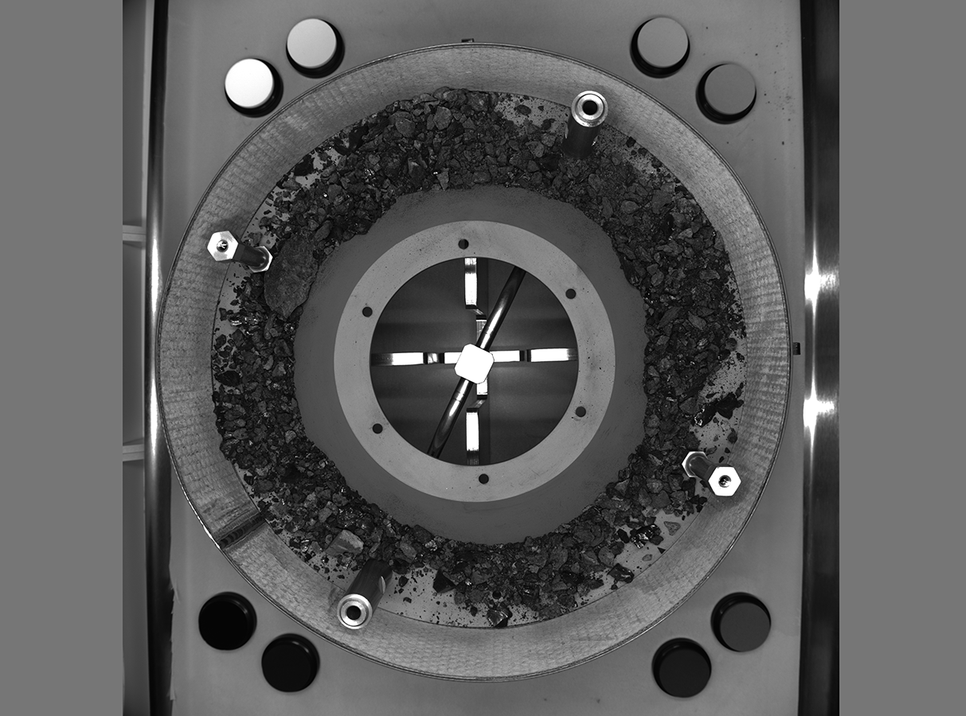
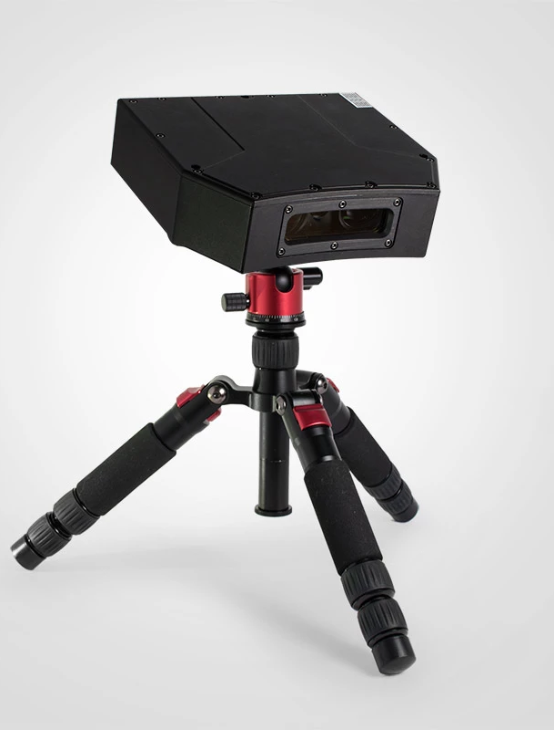
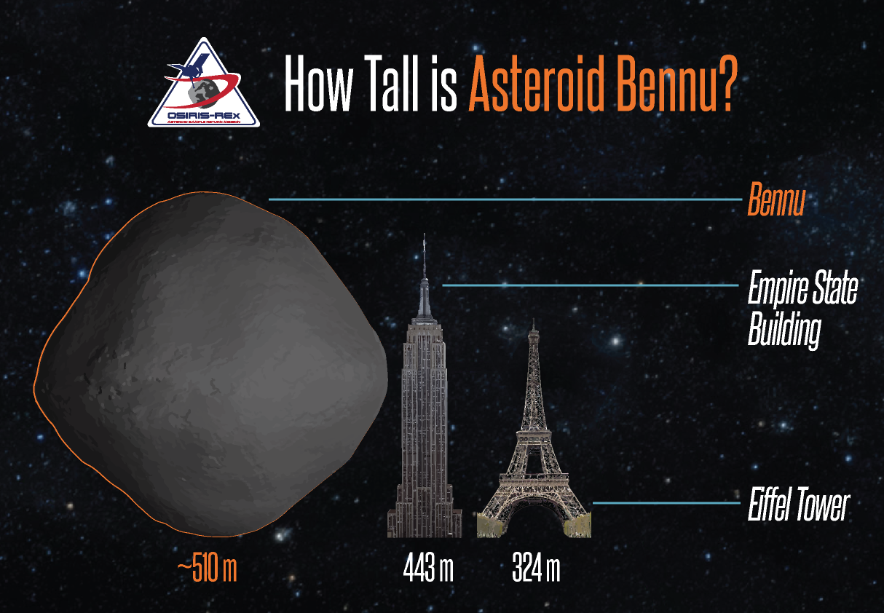
Background
OSIRIS-REx is the first U.S. mission to return samples from an asteroid to Earth
Retrieved samples will be placed in a nitrogen glove box to avoid contamination and analyzed via 3D structured light scanner
Notes:
>1 billion dollars!
Want to make sure gaining valuable data from this groundbreaking mission

Slide 3

Objectives
To understand solar system formation and develop mitigation measures against asteroid impacts
Scanner will examine Bennu sample volume, density, roughness, and select candidates for further research
Scanner’s uncertainty and error must be determined
Want to determine:
Ideal orientation for scanner
Scanner error
Impact of scanning through glovebox window
Best sample candidates for scanning
Notes:
Want to know values to examine Bennu’s origin, creation of our solar system, better understand asteroid deflection
High porosity/smoothness of samples- determine different types of rocks from Bennu’s surface, tells us about its history, what it’s made of, and help us understand the formation of the solar system and by understanding it’s composition we can explore measures to mitigate impact of asteroids on Earth, both of Bennu and for other asteroids

Slide 4
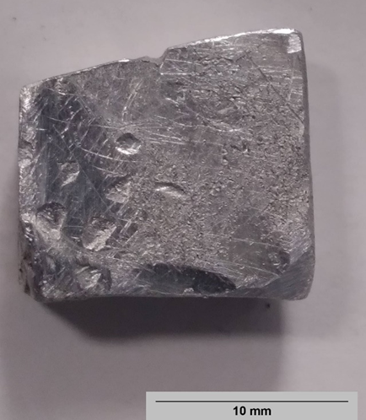
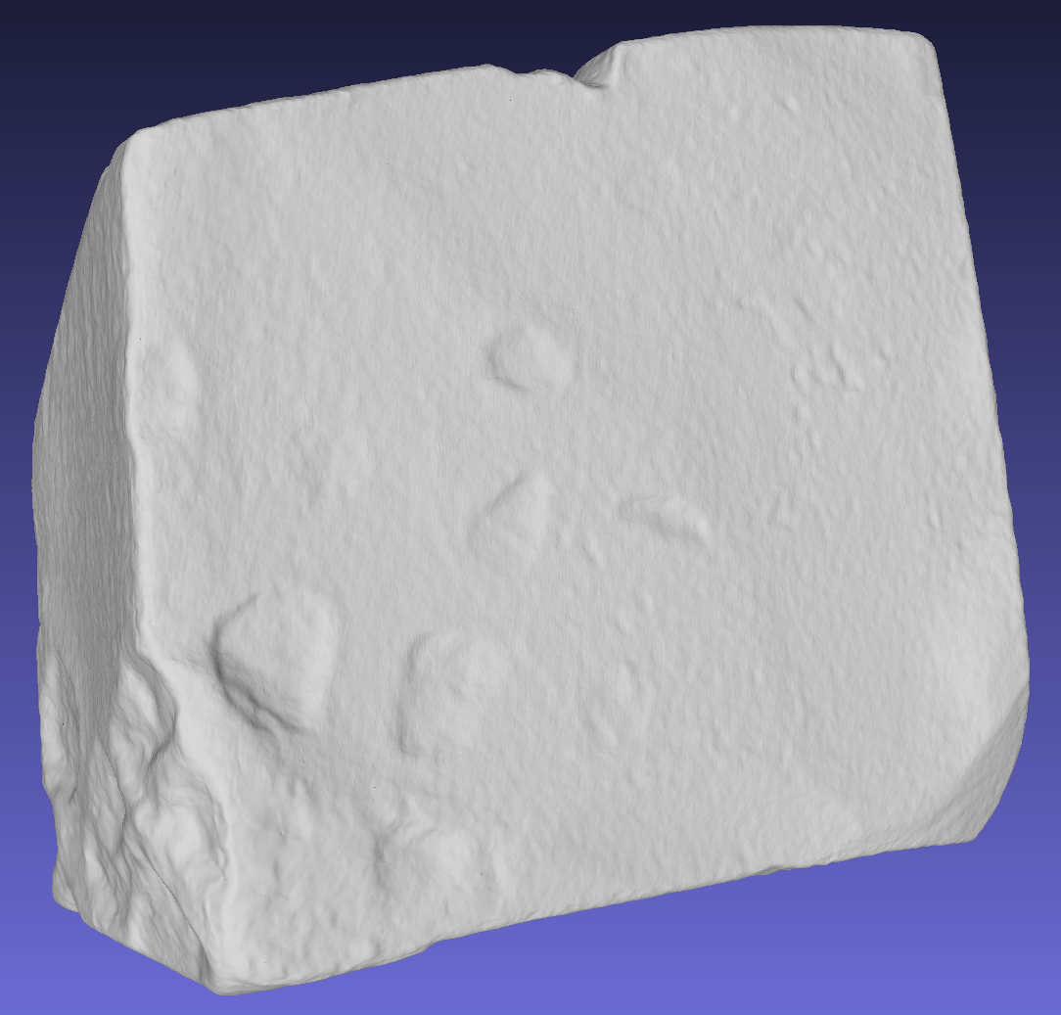
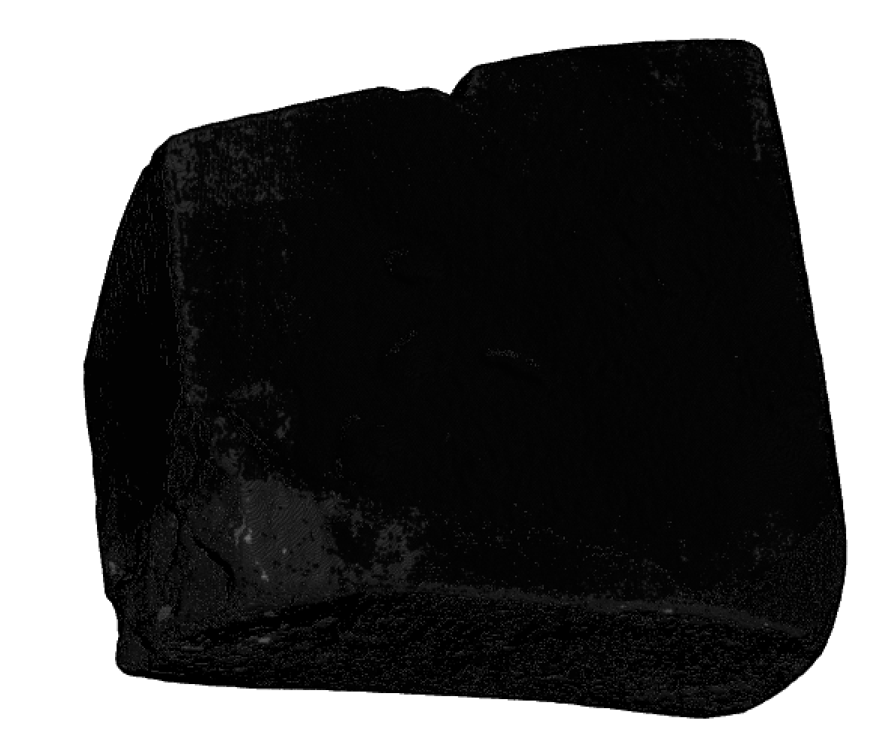
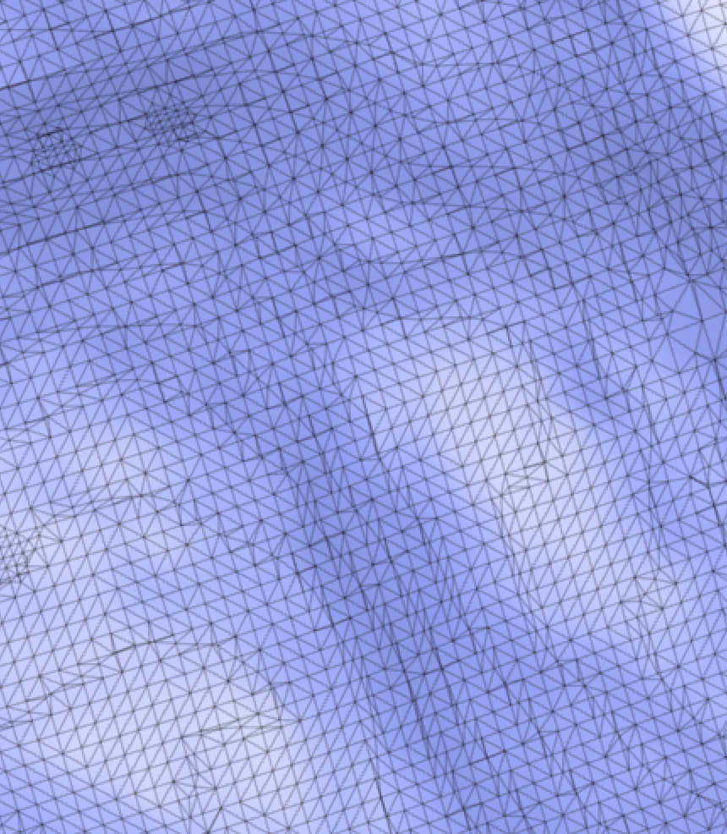
Methods
1100 Aluminum samples of various sizes and features scanned
  Known density of Al means theoretical density can be calculated to find error of scans
From scans, the volume can be determined using the signed volume of the mesh triangles
Notes:
1100 Al, basically just means it’s very pure- minimum of 99.0% aluminum
Because it’s very pure, we know the density of all these samples so just by weighing these samples, we know what volume the scanner should find
The Python program we used calculates the area of all the mesh triangles of the volume surface and uses a reference point outside the object to assign all the triangles a sign. By summing all the meshes together, the overall volume is found. Program is accurate to 12 decimal points, or one trillionth of a mm^3

Slide 5
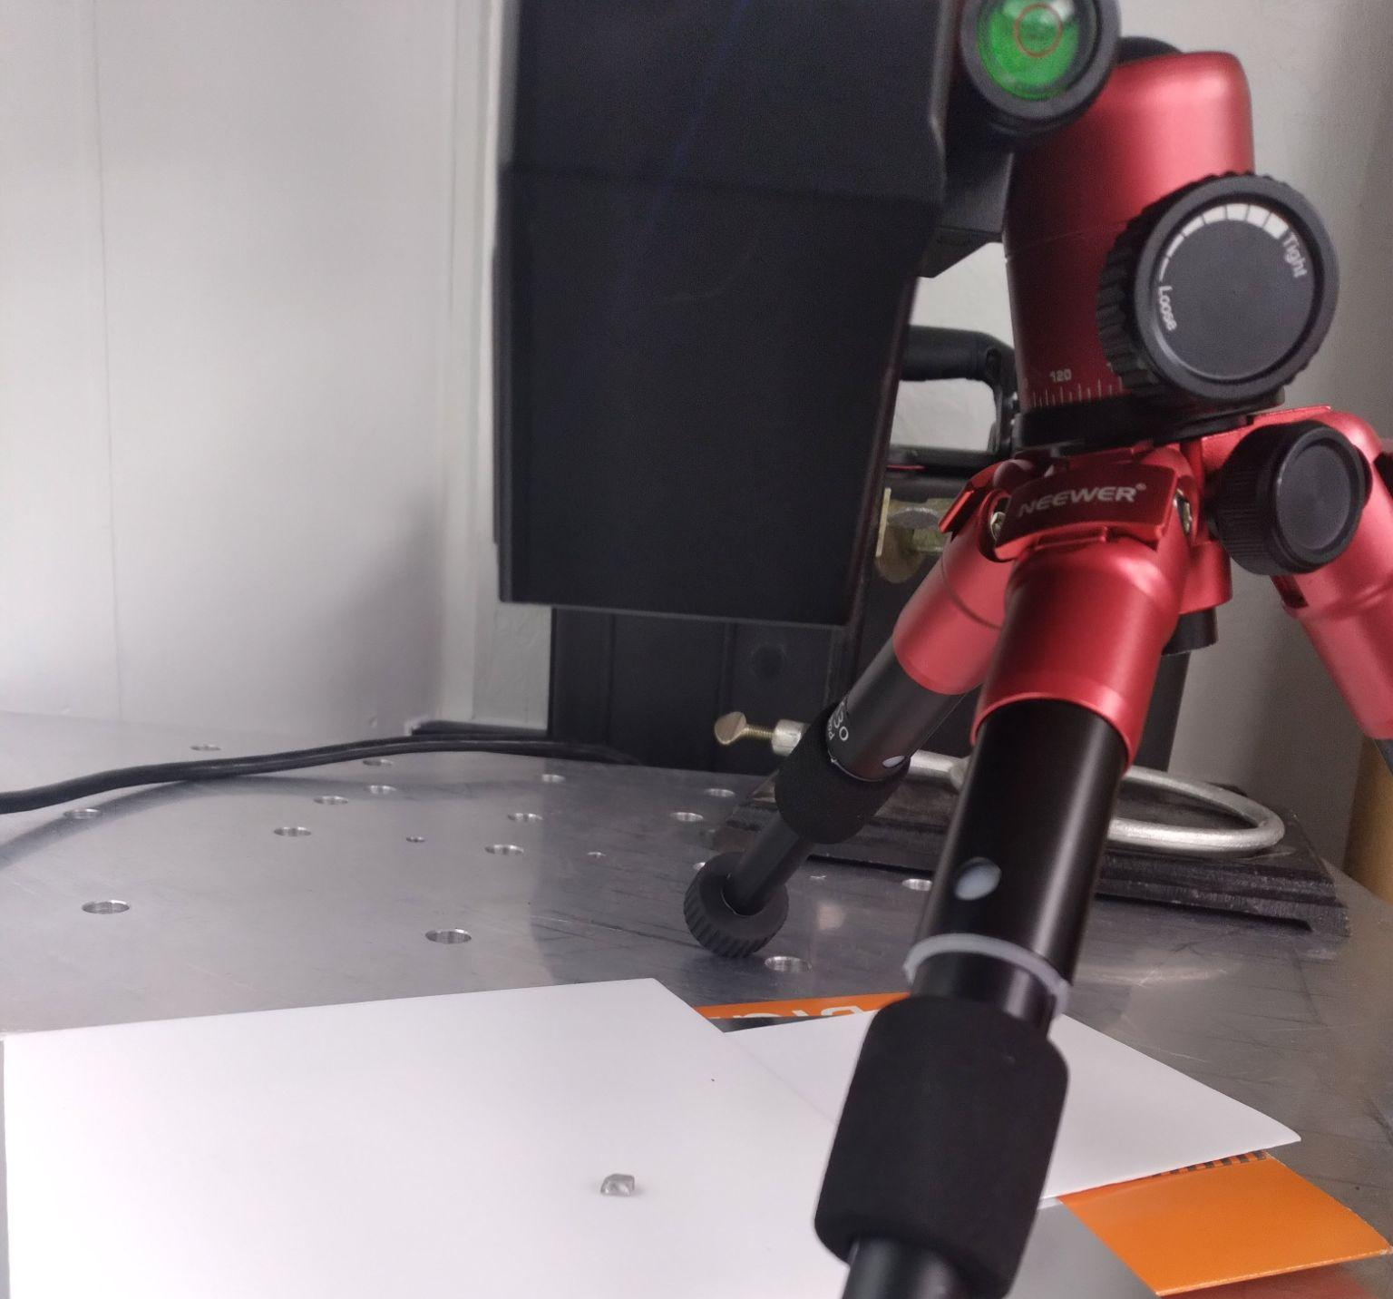
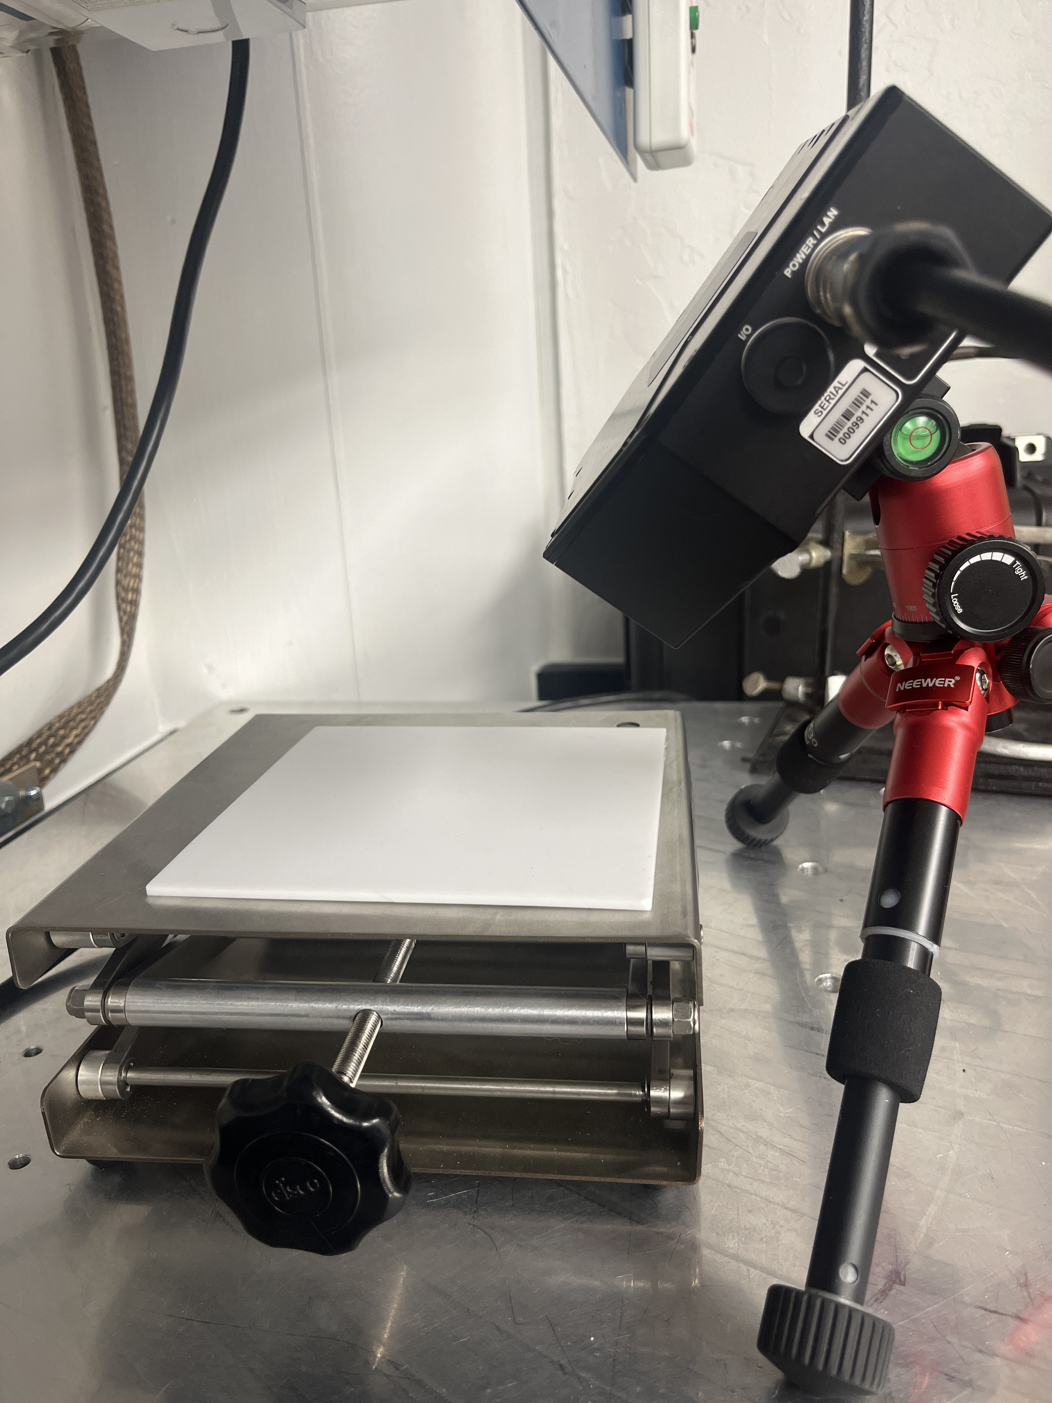
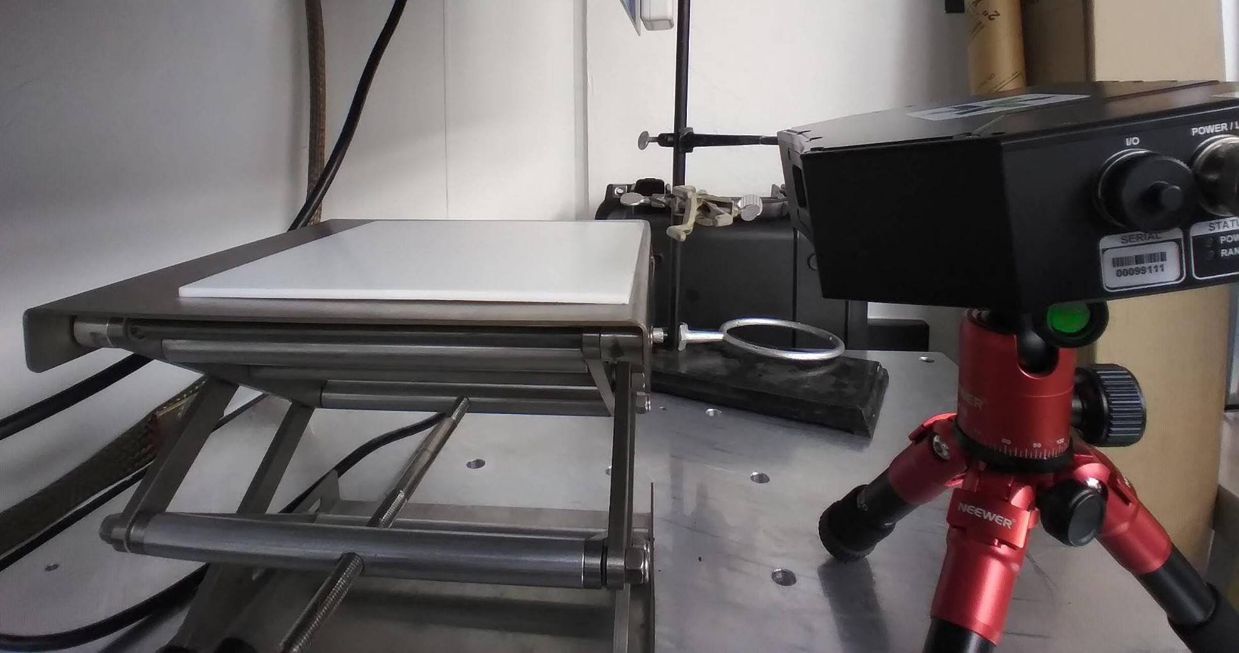
Results- Orientation
3 options: 0°, 45°, 90°
0° had best results
  45° issues in image distortion & resolution due to sensitive sample placement
  90° issues in connecting planes
0°
90°
0°
45°

Slide 6

Results- Scanner Error
Large samples (mass>0.5g) have an average percent error of 0.202% +/- 0.217 from theoretical value
Different trials on the same sample had an average of 0.007499% difference in volume
Smaller samples (mass <0.5g) have an average percent error of 0.980 +/-0.905% error
Notes:
Incredibly reliable. Error does increase in small samples, but still error remains less than 2%, which is much better than expected
Means main sources of error are human error- not aligning scans correctly, or not cleaning up extra artifacts in the scans- not taking enough scans to fill in holes

Slide 7
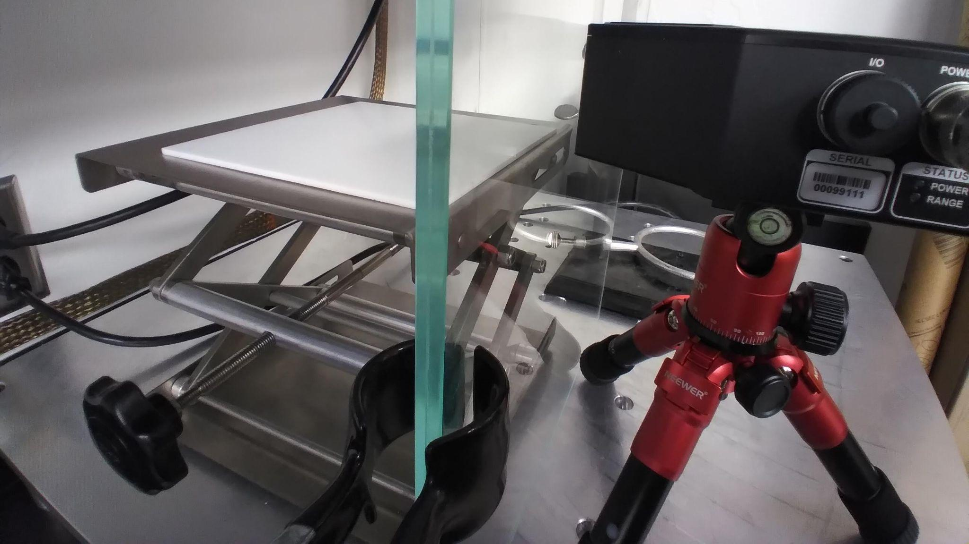
Results- Scanner Error with Window
Average percent error = 0.803% +/- 0.094 from theoretical value
Distortion from glass pane negligible
Notes:
While window did show very slight loss in the volume of a sample that could be scanned at once, it was not an issue in scanning accuracy, simply required more scans

Slide 8
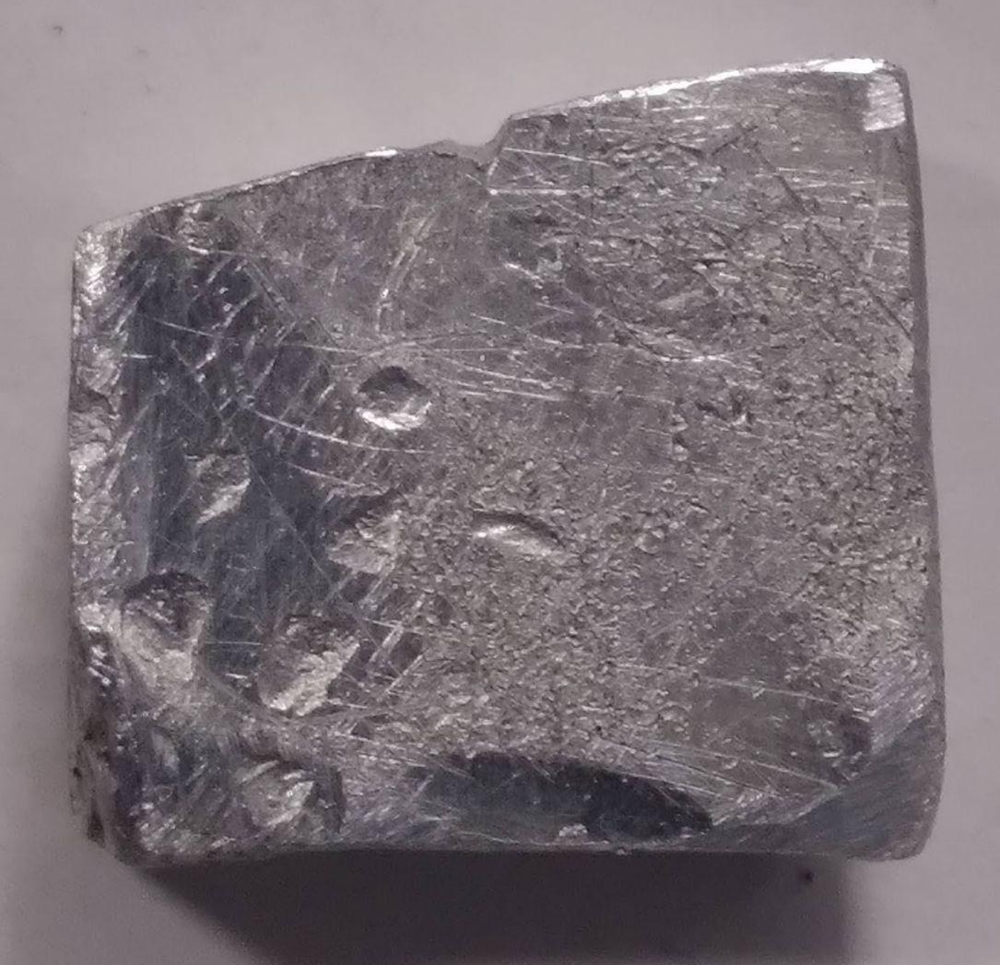
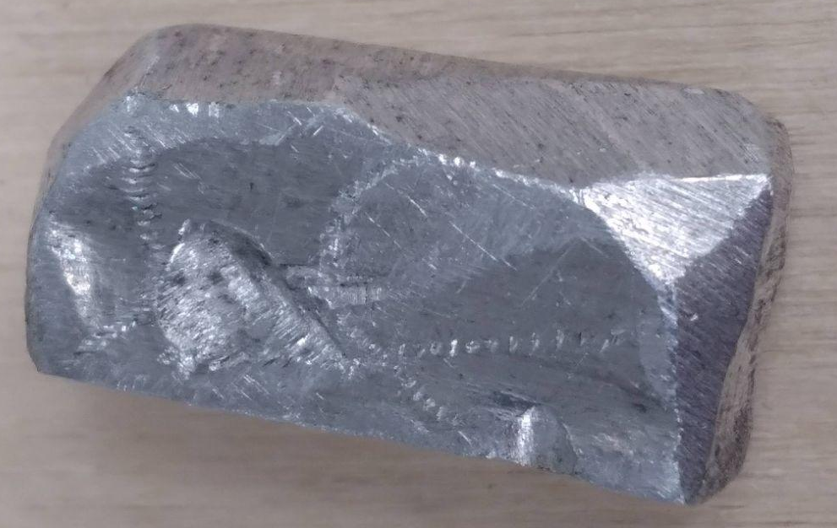


Results- Sample Candidates
Best sample candidates have:
  No knife edges
  Matte finish
  No cleavage
  Large surface indentations

Slide 9
Conclusion/Discussion
Ideal orientation for scanner is 0°
Reliable method of finding volume and porosity of samples with <2% error
Nitrogen glove-box window pane error negligible
Features for samples best for scanning analysis identified
Smaller and smaller samples will be tested to see decline in accuracy with decreasing mass

Slide 10

Acknowledgements
A hearty thank you to everyone who has helped on this project:
Andrew Ryan, Carina Bennett, Dolores Hill, Michelle Coe
Thank you to Space Grant, University of Arizona, and NASA for their generous funding, and ASU for hosting this symposium
ARIZONA SPACE GRANT CONSORTIUM

Slide 11
Thank you!

